Slide 1
Parslo: A Gradient Descent-based Approach for Near-optimal Partial SLO Allotment in Microservices
Socc 2021
University of Michigan, Microsoft Research

Slide 2
Background

Slide 3
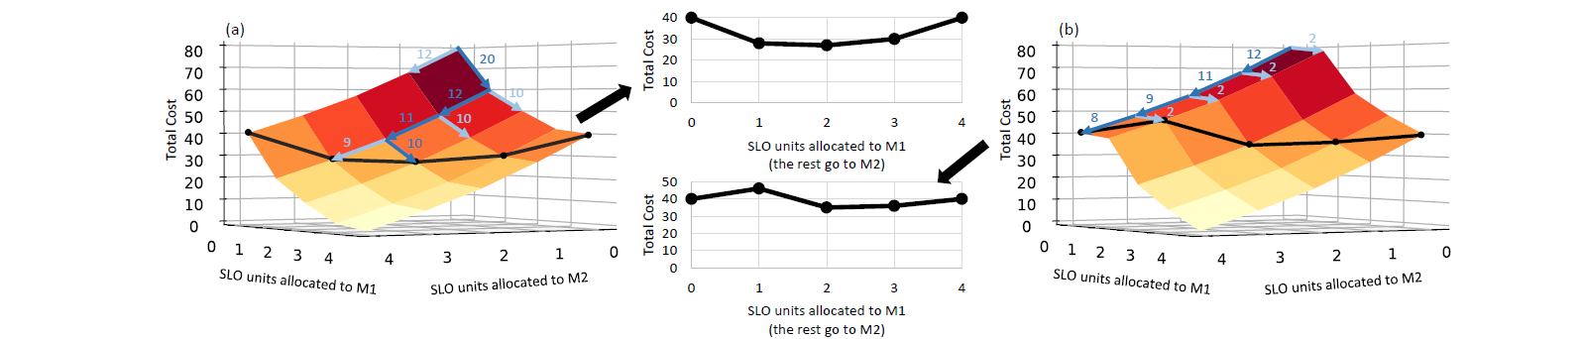
INTRODUCTION
Service Level Objectives (SLOs) define end-to-end latency targets for the entire service to ensure user satisfaction. In such environments, each microservice is independently deployed and (auto-)scaled. However, it is unclear how to optimally scale individual microservices when end-to-end SLOs are violated or underutilized, and how to size each microservice to meet the end-to-end SLO at minimal total cost.
Parslo: a Gradient Descent-based approach to assign partial SLOs among nodes in a microservice graph under an end-to-end latency SLO. At a high level, the Parslo algorithm breaks the end to end SLO budget into small incremental “SLO units”, and iteratively allocates one marginal SLO unit to the best candidate microservice to achieve the highest total cost savings until the entire end-to-end SLO budget is exhausted.
Notes:
服务水平目标 (SLO) 定义了整个服务的总的延迟目标，以确保用户满意。在这样的环境中，每个微服务都是独立部署和（自动）扩展的。然而，当总的SLO 在被违反或未被充分利用时，如何以最佳方式扩展单个微服务，以及如何调整每个微服务的大小以满足总的SLO 的总成本最低，目前尚不清楚。
在本文中，我们提出了 Parslo——一种基于梯度下降的方法，用于在总的延迟 SLO 下在微服务图中的节点之间分配部分 SLO。Parslo 算法将总的SLO 预算分解为小的增量“SLO 单元”，并迭代地将一个 SLO 单元分配给最佳候选微服务，以实现最高的总成本节约，直到整个结束总的SLO 预算已用尽。（水平拓展）

Slide 4
Recent Works
There are two general approaches to address this issue:
Most existing and deployed systems as well as classic research proposals assign Partial SLOs to individual microservices
to ensure each microservice can be independently managed and scaled through its own autoscaling framework.
1.This approach is cheap and straightforward especially because different microservices may be implemented atop different cluster management frameworks, which are not easy to integrate.
2.However, existing systems assign partial SLOs to microservices through ad hoc and empirical mechanisms, which may result in a suboptimal total cost.
Some recent research proposals advocate end-to-end auto-scaling frameworks, wherein a single controller makes the scaling decisions for all microservices upon traffic changes, using machine learning-based techniques .
1.these schemes are able to quickly react to changes in the microservice graph topology
2.they impose a significant overhead for implementing an ML-driven centralized controller,
3.they are not trivially scalable to large microservice graphs
4.they require frequent data collection and retraining
5.there is no guarantee of optimality for such systems
Notes:
大多数现有和已部署的系统以及经典研究提案将部分 SLO 分配给单个微服务，以确保每个微服务都可以通过其自己的自动扩展框架进行独立管理和扩展。这种方法既便宜又简单，特别是因为不同的微服务可能在不同的集群管理框架上实现，这些框架不容易集成。然而，现有系统通过临时和经验机制将部分 SLO 分配给微服务，这可能会导致总成本不理想。
(2) 最近的一些研究建议提倡端到端的自动扩展框架，其中单个控制器使用基于机器学习的技术根据流量变化为所有微服务做出扩展决策。
尽管这些方案能够快速响应微服务图拓扑的变化，
但它们为实现 ML 驱动的集中式控制器带来了巨大的开销，它们无法轻松扩展到大型微服务图（计算量过大），它们需要频繁的数据收集和重新训练，最重要的是，无法保证此类系统的最优性——即，它们不一定能以最低成本满足端到端延迟 SLO

Slide 5
SLO Assignment

Slide 6
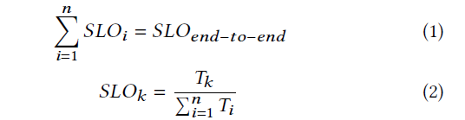
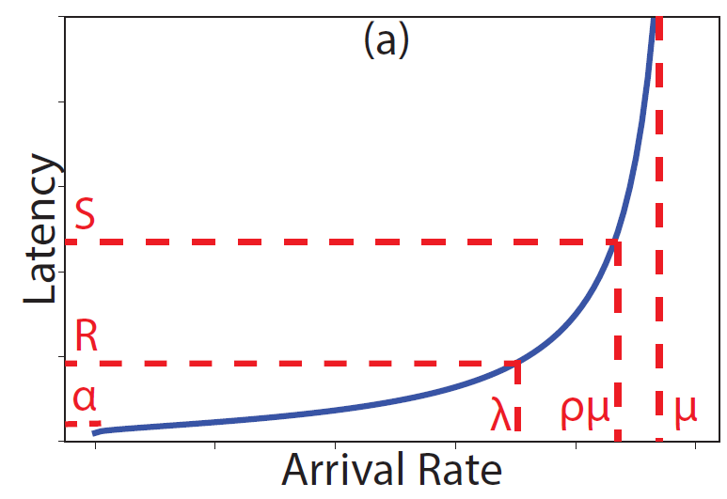
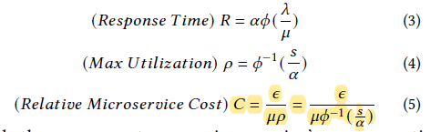
Partial SLO Assignment
Grandslam‘sway
𝑇𝑖: the service time for microservice 𝑖 in a chain
𝛼: the zero-load latency of the microservice
𝜙: function specifies the shape of the LLP graph for the microservice
𝜆: the arrival rate
𝜇: the maximum arrival rate that an instance of the microservice can sustain
𝑠: the partial latency SLO of a microservice
𝜖: the cost of a single instance of a microservice—the model assumes all instances of single microservice have the same cost as it precludes（排除） vertical autoscaling.
Ram Srivatsa Kannan, et al. 2019. Grandslam: Guaranteeing slas for jobs in microservices execution frameworks. In EuroSys.
Notes:
GrandSLAm [22] 建议将端到端延迟 SLO 划分为与其平均服务时间成比例的微服务，如公式 2 所述（𝑇𝑖 表示微服务 𝑖 在链中的服务时间）。
（更近一步）这里我们研究，这类 SLO 分配如何优化端到端的总成本
使用这些参数，可以从公式 3 推断出微服务对到达率 𝜆 的响应时间。同样，如果我们将微服务的部分延迟 SLO 设置为 𝑠，则实例的最大利用率由公式 4 计算。
𝜖 参数指定了单个微服务实例的成本——该模型假设单个微服务的所有实例具有相同的成本，因为它排除了垂直自动缩放。
因此，特定微服务的相对总成本由等式 5 给出。我们认为总成本是一个无单位量，与实例总数和微服务单个实例的相对成本成正比。微服务的实例数与单个实例的最大利用率成反比

Slide 7

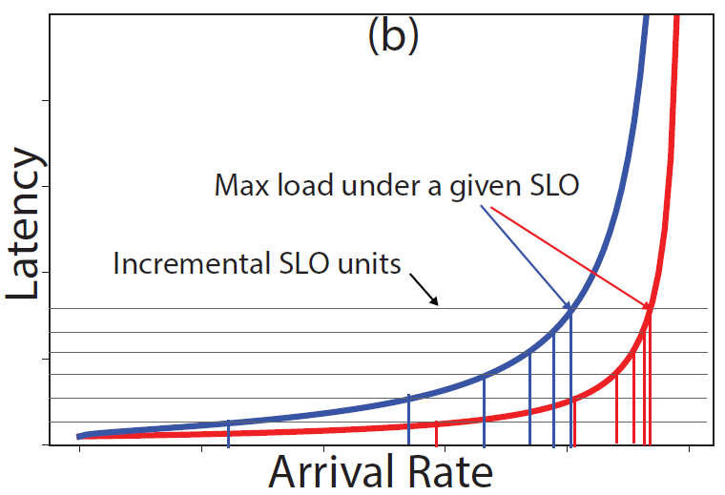


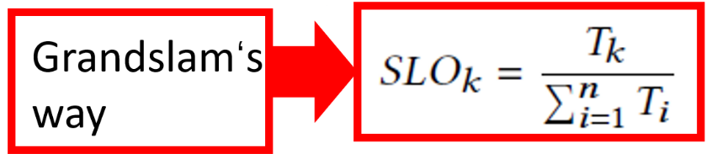
An exmaple
we consider a chain of two microservices. Equation 6 denotes the total cost for the chain, assuming both microservices are operated at their individual maximum utilization.
Find the roots of the derivative of the total cost over 𝑠1, which results in Equation 7.
As an illustrative example To demonstrate the lack of optimality for the SLO assignment approach described in Equation 2, we consider the LLPs presented in Figure 2(b) for the two microservices in the chain. In this case, even if all other
parameters are equal for the two microservices (i.e., equal 𝛼,𝜇,𝜖; only 𝜙s are different) the optimal SLO assignment results in up to 24% lower cost than using Equation 2.
Notes:
我们考虑两个微服务链。等式6表示链的总成本，假设两个微服务都以各自的最大资源利用率运行。
找出总成本的导数的根𝑠1，其结果为等式7。
作为一个说明性的例子来证明在等式2中描述的SLO分配方法缺乏最佳性，我们考虑图2（b）中所示的LLPS，用于链中的两个微服务。在这种情况下，即使所有其他
两个微服务的参数相等（即相等𝛼,𝜇,𝜖; 只有𝜙s不同）与使用等式2相比，最佳SLO分配可使成本降低高达24%。

Slide 8
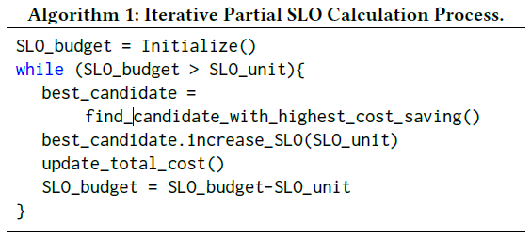

SLO ALLOTMENT
We empirically find that dividing the SLO budget into 1000 SLO units is sufficient for converging to an optimal solution.
The algorithm first initializes all microservices by allocating a single SLO unit to them.
The cost saving of a particular microservice node for allocating one marginal SLO unit is formulated in Equation 8 (Δ𝑠 denotes the marginal SLO unit.
The algorithm continues allocating SLO units one at a time until the entire end-to-end SLO budget is exhausted.
Cost savings decrease as the algorithm progresses since the LLP graphs are usually steeper at higher loads, as shown in Figure 2(b).
Notes:
我们经验发现，将SLO预算划分为1000个SLO单元就足以收敛到最优解。
该算法首先通过为所有微服务分配一个SLO单元来初始化它们。
分配一个边际SLO单元的特定微服务节点的成本节约在等式8（Δ𝑠 表示边际SLO单位。
该算法继续一次分配一个SLO单元，直到耗尽整个端到端SLO预算。
随着算法的发展，成本节约会减少，因为LLP图在较高负载下通常更陡峭，如图2（b）所示。

Slide 9
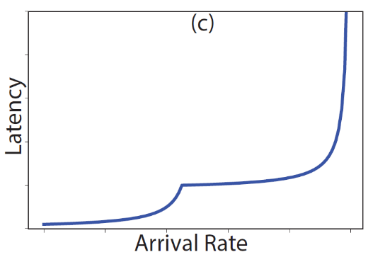
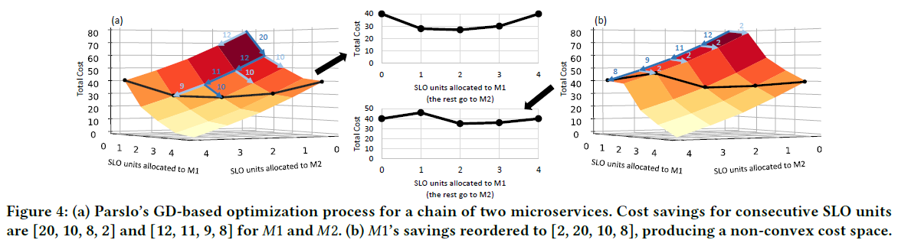
SLO ALLOTMENT
As shown in the figure, the algorithm considers the “gradient information” of the cost space at each point, represented as blue arrows, to allocate the next SLO unit to the microservice with the highest cost saving.
Figure 4(b) reorders the cost savings for 𝑀1 to [2, 20, 10, 8], producing a non-convex search space.
An example rare case for such LLPs can be found in bare-metal servers where a power-related. in our experiments Parslo found partial SLOs with up to 36% error with respect to the optimal solution if one of the LLPs had non-increasing slopes, similar to 2(c).
Notes:
如图所示，该算法考虑了每个点的成本空间的“梯度信息”，用蓝色箭头表示，以将下一个SLO单元分配给成本节约最高的微服务。
图4（b）重新排列了𝑀1到[2,20,10,8]，生成非凸搜索空间。
这种LLP的一个罕见例子可以在与电源相关的裸机服务器中找到。在我们的实验中，Parslo发现，如果其中一个LLP的斜率与2（c）类似，那么相对于最优解，部分SLO的误差高达36%。

Slide 10
Complicated DAGs

Slide 11
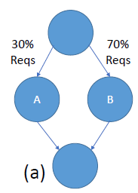
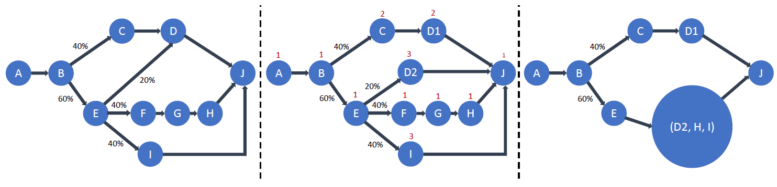
Dynamic Branching
Branch through multiple paths, as shown in Figure 3(a). Branching makes partial SLO assignment more complicated since all microservices are no longer on the end-to-end critical path.
First, Parslo seeks to equalize the SLO across all paths. To ensure it is possible to equalize all paths, Parslo only
supports a particular class of DAGs, known as Nested Fork Join (NFJ) DAGs.
For example, Figure 5(a) depicts a non-NFJ DAG that has been converted to an NFJ DAG in Figure 5(b) by replicating node D into nodes D1 and D2.
With branches, the cost of each node must be weighted by the fraction of requests passing through the node. For example, in Figure 5(b) the cost of node I is weighted by 0.24 (0.4×0.6). During initialization, Parslo ensures that all branches of a fork are allocated an equal total budget of the initial SLO.
Thus, Parslo employs an alternative recursive procedure and then combines all branches into a single node
Figure 5(b) lists all potential candidates for allocating marginal SLO in each iteration.
Notes:
通过多条路径进行分支，如图3（a）所示。分支使部分SLO分配更加复杂，因为所有微服务不再位于端到端关键路径上。
首先，Parslo寻求在所有路径上均衡SLO。为了确保所有路径的均衡，仅限Parslo 支持一类特殊的DAG，称为嵌套分叉连接（NFJ）DAG。
例如，图5（a）描述了通过将节点D复制到节点D1和D2中而转换为图5（b）中NFJ DAG的非NFJ DAG。
对于分支，每个节点的成本必须由通过该节点的请求的分数来加权。例如，在图5（b）中，节点I的成本加权为0.24（0.4×0.6）。在初始化过程中，Parslo确保fork的所有分支都分配了与初始SLO相同的总预算。
因此，Parslo采用了另一种递归过程，然后将所有分支组合成一个节点

Slide 12
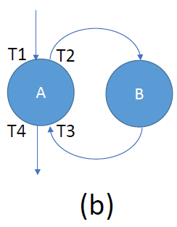
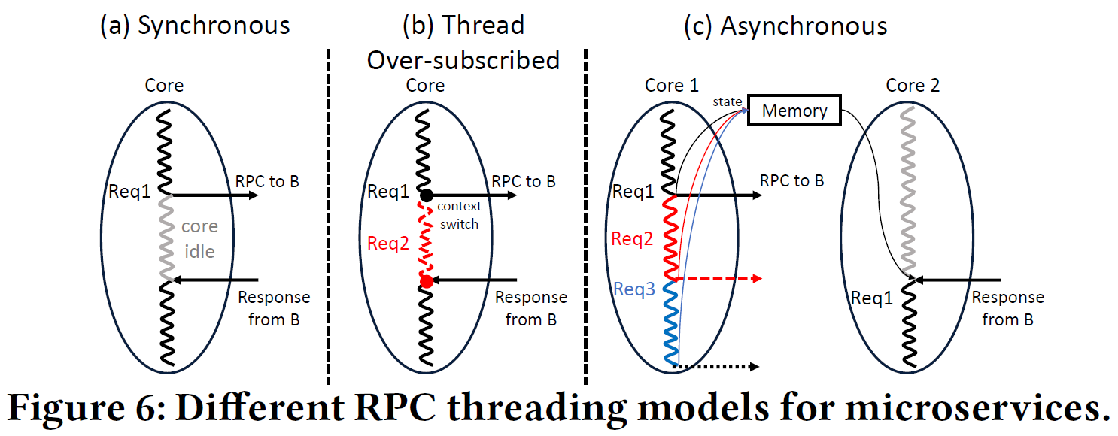
RPCs and Dependencies
The majority of non-leaf microservices are implemented using Remote Procedure Calls (RPCs), wherein a microservice issues subsequent requests to another microservice while processing a request and is only able to continue processing the request after it receives a response from the next-tier microservice, as shown in Figure 3(b). Response time of a request at the first microservice (𝐴) depends on the response time at the second microservice (𝐵).
𝐴 may be implemented synchronously, where in each core processing a request issues a subsequent request to 𝐵 and waits until the response arrives back, as in Figure 6(a). During this period, the core remains idle even if there are outstanding requests in the queue.
𝐴 may instead be implemented in a thread over-subscribed manner, shown in Figure 6(b), wherein the number of processing threads is larger than the number of cores. In this case, when a thread is stalled, waiting for the next-tier response, it is context switched with another thread to process another request and keep the core bus
Notes:
大多数非叶微服务是使用远程过程调用（RPC）实现的，其中一个微服务在处理请求时向另一个微服务发出后续请求，并且只有在收到下一层微服务的响应后才能继续处理该请求，如图3（b）所示。
以最直接的方式，𝐴 可以同步实现，其中每个处理请求的核心向 𝐵 发出后续请求，并等待响应返回，如图 6(a) 所示。在此期间，即使队列中有未完成的请求，核心仍保持空闲状态
为了优化利用率和吞吐量，可以改为以线程超额订阅的方式实现，如图 6(b) 所示，其中处理线程的数量大于内核的数量。在这种情况下，当一个线程停顿，等待下一层响应时，它与另一个线程进行上下文切换以处理另一个请求并保持核心总线

Slide 13
RPCs and Dependencies
𝐴 may be implemented asynchronously, as shown in Figure 6(c), wherein the number of threads is the same as the number of cores but each thread picks a new request after issuing the subsequent request to 𝐵 and continues processing the previous request when the response from 𝐵 returns, using an explicit state machine to track the partial progress of the requests. Asynchronous implementations are more complicated but more efficient.
A key requirement in Parslo is that different microservices must exhibit LLPs that are independent of one another.
When a microservice is implemented in an over-subscribed or asynchronous manner (i.e., options (2) or (3) above) its throughput behavior is independent of the next-tier microservice latency as cores do not remain idle while a request is waiting for a response.
To isolate the latency behavior from the next tier, we define the response time of a request as the time a request has spent waiting or processing within a microservice, excluding the time a microservice waits for the next-tier response.
the recorded response time for a request in Figure 3(b) would be (𝑇4 −𝑇1)−(𝑇3 −𝑇2))
Notes:
𝐴可以异步实现，如图6（c）所示，其中线程数与内核数相同，但每个线程在向𝐵发出后续请求后选择一个新请求，并在𝐵 的响应返回，使用显式状态机跟踪请求的部分进度。异步实现比过度订阅的实现要复杂得多，但效率更高，因为它们不会产生上下文切换开销
Parslo 的一个关键要求是不同的微服务必须展示彼此独立的 LLP。当一个微服务以超额订阅或异步方式（即上面的选项（2）或（3））实现时，它的吞吐量行为独立于下一层微服务延迟，因为在请求执行时核心不会保持空闲等待回复。
为了将延迟行为与下一层隔离开来，我们将请求的响应时间定义为请求在微服务内等待或处理的时间，不包括微服务等待下一层响应的时间

Slide 14
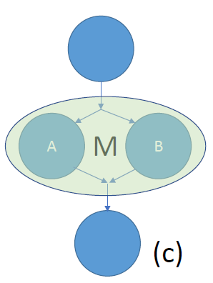
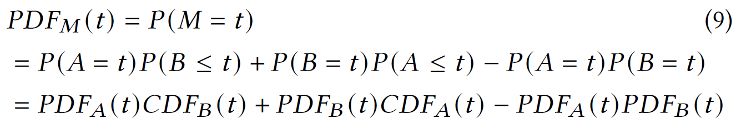
Parallel Fan-out
This pattern arises in search and retrieval use cases. With sharded retrieval, the root node must wait until the responses from all shards return. Unlike hash-based sharding (as in key-value stores), in parallel sharded microserves, the number of shards is usually fixed.
In Parslo, we represent all the parallel shards as a single microservice node in the DAG, subject to a single partial SLO, since they operate concurrently and scale in/out together.
The LLP of a microservice node to calculate cost savings—represents the mean or tail of the latency distribution.
the LLP either has to be measured at the entire microservice node with all the shards operating concurrently, or measured at a single shard, transformed to derive the LLP of the entire microservice node.
When a request goes through two parallel paths within a microservice node and the latency of the entire node is determined by the slowest path, as shown in Figure 3(c), the Probability Distribution Funciton (PDF) of the entire microservice can be inferred from the measured distributions at the two parallel paths using Equation 9, assuming the latencies of the two paths are independent.
Notes:
这种模式出现在搜索和检索用例中，使用分片检索，根节点必须等到所有分片的响应返回。与基于散列的分片（如在键值存储中）不同，在并行分片微服务中，分片的数量通常是固定的.
在 Parslo 中，我们将所有并行分片表示为 DAG 中的单个微服务节点，受制于单个部分 SLO，因为它们同时运行并一起扩展/扩展。
微服务节点的 LLP（Parslo 算法使用它来计算成本节省）表示所有负载下延迟分布的平均值或尾部。
因此，LLP 要么必须在所有分片同时运行的整个微服务节点上测量，要么在单个分片上测量，然后转换为整个微服务节点的 LLP。
当一个请求通过一个微服务节点内的两条平行路径，并且整个节点的延迟由最慢路径决定时，如图3（c）所示，假设两条路径的延迟是独立的，则可以使用等式9从两条平行路径处测得的分布推断出整个微服务的概率分布函数（PDF）。

Slide 15
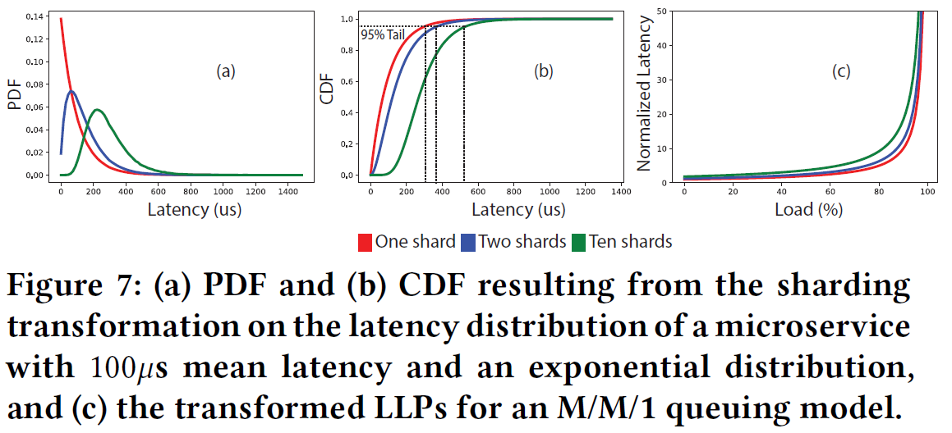
Parallel Fan-out
Figure 7 illustrates the impact of inferring the PDF (a) and CDF (b) functions of a sharded microservice based on the latency distribution of a single instance, which is assumed to exhibit a 100𝜇s mean latency with an exponential distribution. As these figures show, sharding causes the probability of small latencies to decrease while resulting in a higher probability for large latencies, since the overall microservice latency is determined by the slowest shard.
Figure 7(c) presents the resulting LLP graphs for a sample microservice with an M/M/1 queueing system, for different numbers of shards. Parslo calculates the cost of sharded microservices based on such transformed LLP graphs using Equation 9.
Notes:
图7说明了基于单个实例的延迟分布推断分片微服务的PDF（a）和CDF（b）功能的影响，假设该实例显示了100𝜇s平均延迟呈指数分布。如这些图所示，切分导致小延迟的概率降低，同时导致大延迟的概率更高，因为总体微服务延迟由最慢的切分决定。
图7（c）给出了一个带有M/M/1排队系统的示例微服务的LLP图，其中包含不同数量的碎片。Parslo根据转换后的LLP图，使用等式9计算分片微服务的成本。

Slide 16
Offline Tail Estimation Model

Slide 17
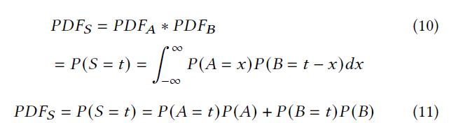
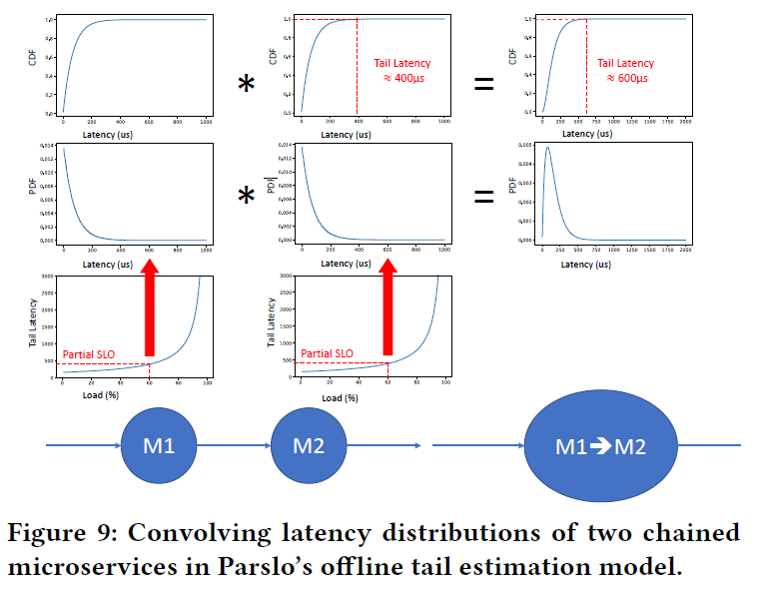
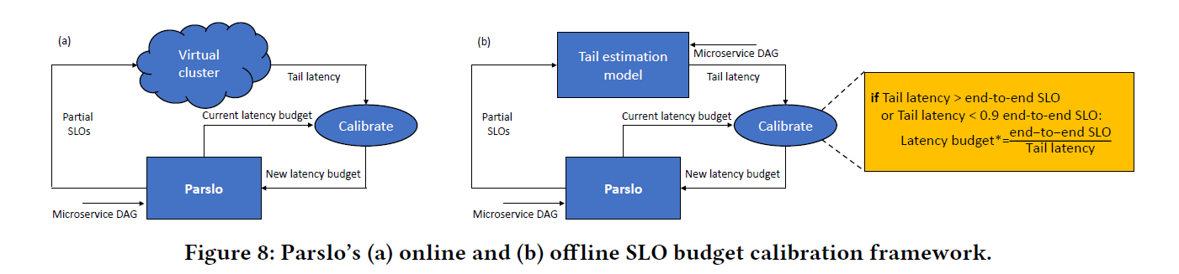
Tail Model Calibration
Average latency or tail latency: the end-to-end tail latency may be much smaller than the sum of the tail latencies of 𝐴 and 𝐵.
We propose an offline tail estimation model to enable offline calibration of Parslo’s latency budget, shown in Figure 8(b). The model estimates the end-to-end tail latency given a set of partial SLOs for all microservice nodes, by modeling the microservice DAG as a network of queues.
Assuming all microservice nodes are independent, we can combine these distributions to derive the end-to-end latency distribution for the entire DAG, to estimate the end-to-end.
Notes:
平均延迟或尾部延迟：端到端尾部延迟可能远小于𝐴 和𝐵.
我们提出了一个离线尾部估计模型，以实现 Parslo 延迟预算的离线校准，如图 8(b) 所示。该模型通过将微服务 DAG 建模为队列网络，在给定所有微服务节点的一组部分 SLO 的情况下估计端到端尾部延迟。
将部分 SLO 分配给微服务节点后，每个微服务实例可以运行的最大负载将是已知的，这对应于测量的延迟分布，如图 9 所示 - LLP 图上的每个点微服务是延迟分布的总结。假设所有微服务节点都是独立的，我们可以结合这些分布来推导出整个 DAG 的端到端延迟分布，来估计端到端的延迟分布

Slide 18
EVALUATION

Slide 19
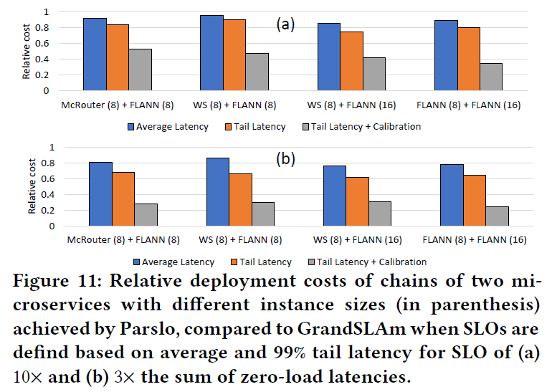
Synthetic DAGs
For synthetic DAGs, we employ stochastic queuing simulation, using the BigHouse Framework, based on the measured service time distributions of three common microservices from: FLANN, McRouter, and Word Stemming (WS).
Notes:
对于合成DAG，我们使用BigHouse框架，基于三种常见微服务的测量服务时间分布，采用随机排队模拟：FLANN、McRouter和Word Stemming (WS)。
图 11：Parslo 实现的具有不同实例大小（括号内）的两个微服务链的相对部署成本，与 GrandSLAm 相比，当 SLO 基于平均和 99% 的 SLO 的尾延迟（a）10×和（ b) 3×零负载延迟的总和

Slide 20
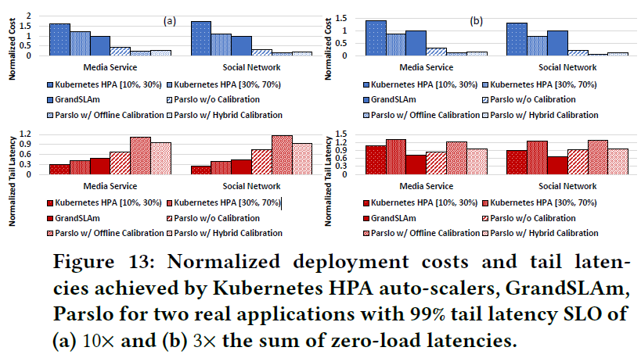
Real-World Applications
Two real microservice-based applications from DeathStarBench [15], social network and media service, deployed in Kubernete.
Notes:
对于合成DAG，我们使用BigHouse框架，基于三种常见微服务的测量服务时间分布，采用随机排队模拟：FLANN、McRouter和Word Stemming (WS)。
图 11 报告了 Parslo 与 GrandSLAm 的成本比

Slide 21
DISCUSSION

Slide 22
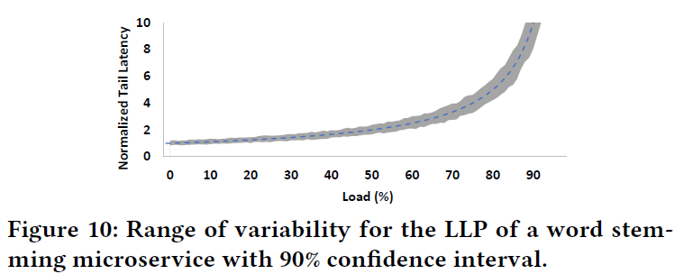
Why Near-optimal?
Parslo assumes all instances of a microservice exhibit the same reproducible LLP behavior(deployed atop VMs with dedicated resources or in containerized microservices)
Interference from co-runners on the underlying physical machine, even with dedicated resources for each instance.
Based on our experiments, for containerized microservices deployed in Kubernetes with resource limits set to be equal to resource requests, LLPs exhibit less than 15% variation from the mean 90% of the time, as shown in Figure 10.
Notes:
来自底层物理机器上的共同运行者的干扰，即使每个实例都有专用资源。
根据我们的实验，对于部署在 Kubernetes 中且资源限制设置为等于资源请求的容器化微服务，LLP 与平均 90% 的时间相比表现出不到 15% 的变化，如图 10 所示。Parslo 可能解释了 LLP 的可变性（由于共同运行者、灵活的资源分配、垂直扩展等）在微服务中通过将 LLP 上的每个数据点建模为具有平均值和标准偏差的值分布而不是单个值，类似于图 10，并分配部分 SLO 以最小化总成本分布的高分位数（例如，95𝑡ℎ 百分位数）。

Slide 23
Changes in Workload Characteristics
Every time the workload characteristics change (i.e., DAG topology, branch probabilities), the Parslo algorithm must be re-run to re-calculate partial SLOs.
Furthermore, in case the LLP of a microservice is subject to change due to changes in instance type/size, the LLP must be re-profiled.
However, these changes happen at coarse time granularities (i.e., hours or days), which makes the time required for Parslo to calculate new SLOs negligible.
Changes in request traffic rates may occur rapidly (i.e., milliseconds), due to load spikes, etc. However, traffic bursts are addressed by the underlying autoscaling mechanism, and Parslo need not recalculate SLOs upon traffic load changes. In fact, Parslo’s main goal is to feed the auto-scalers with near-optimal partial SLOs so they can quickly re-scale the system at minimal cost
Whereas it is possible to find the optimal solution for horizontal auto-scaling—as done by Parslo—the search space for vertical scaling is hyper-dimensional as we need to scale each instance of all microservices, rather than each microservice, independently. Thus, ML-based frameworks are preferred for vertical scaling
Haoran Qiu, et al. FIRM: An Intelligent Fine-Grained Resource Management Framework for SLO-Oriented Microservices. OSDI (2020)
Yanqi Zhang, et al. 2021. Sinan: ML-based and QoS-aware resource management for cloud microservices. In Proceedings of the 26th ACM International Conference on Architectural Support for Programming Languages and Operating Systems. 167–181
Notes:
每当工作负载特性发生变化时（即DAG拓扑、分支概率），必须重新运行Parslo算法以重新计算部分SLO。此外，如果微服务的LLP因实例类型/大小的变化而发生变化，则必须重新分析LLP。然而，这些变化发生在粗粒度时间（即小时或天），这使得Parslo计算新SLO所需的时间可以忽略不计。
由于负载峰值等原因，请求流量率可能会迅速发生变化（即毫秒）。然而，流量突发是通过底层的自动缩放机制解决的，Parslo不需要在流量负载变化时重新计算SLO。事实上，Parslo的主要目标是为自动定标器提供接近最优的部分SLO，以便它们能够以最小的成本快速重新调整系统
虽然可以找到水平自动缩放的最佳解决方案（正如 Parslo 所做的那样），但垂直缩放的搜索空间是超维的，因为我们需要独立缩放所有微服务的每个实例，而不是每个微服务。因此，基于 ML 的框架更适合垂直缩放

